Slide 1
Model Tuning

Slide 2
Outline
Model Tuning
Data Science Project Life Cycle
Case Study

Slide 3
Model Parameters
Model parameter is a configuration variable that is internal to the model whose value can be estimated from the underlying data
These are required by the model when making predictions
These values define the skill of the model on your problem
These are estimated or learned from the underlying data
These are not manually set by data scientist
They are often saved as part of the learned model
Parameters are key to machine learning algorithms. They are part of the model that is learned from historical training data
Examples:
The coefficients in a linear or logistic regression

Slide 4
Model Hyperparameters
Model parameters are learnt during training(eg: intercept and slopes in Linear Regression)
Model hyperparameters are set by data scientist ahead of training
Hyperparameters are parameters that are not directly learnt within estimators
Examples for hyperparameters?
In scikit-learn these are passed as arguments to the constructor of the estimator classes
Intercept and slopes learnt during training of a Linear Regression model are model parameters while the number of trees in a Random Forest is a model hyperparameter because it is set by data scientist
It is possible and recommended to search the hyperparameter space for the best cross validation score.

Slide 5
Model Hyperparameters
A model hyperparameter is a configuration that is external to the model and whose value cannot be estimated from data
They are often used in processes to help estimate model parameters
They are often specified by data scientist
They can often be set using heuristics
They are often tuned for a given predictive modelling problem
We cannot know the best value for a model hyperparameter on a given problem. We may use rule of thumb, copy values used in other problems, or search for the best value by trial and error
When a machine learning algorithm is tuned for a specific problem, then you are tuning the hyperparameters of the model that result in the most skilful predictions

Slide 6
Model Hyperparameters
Hyperparameters can be thought of as model settings
These settings need to be tuned for each problem as the best model hyperparameters for one particular data set will not be the best across all data sets
The process of hyperparameter tuning (also referred as hyperparameter optimization) means finding the combination of hyperparameter values for a machine learning model that performs the best – as measured on a test data set – for a given problem
A lot of data scientists use the terms ‘parameters’ and ‘hyperparameters’ interchangeably to refer to the model settings. This is technically incorrect.
If you have to specify a model parameter manually then it is probably a model hyperparameter

Slide 7
Hyper parameters: Examples
Linear Regression, Logistic Regression, Naïve Bayes
No hyper parameters
kNearestNeighbors
Number of neighbors
Decision Trees
min_samples_leaf
min_samples_split
criterion
Random Forest
n_estimators
max_depth
min_samples_split
min_samples_leaf
max_features
etc
AdaBoost
n_estimators
learning_rate
Gradient Boosting
n_estimators
max_depth
learning_rate
max_features
etc

Slide 8
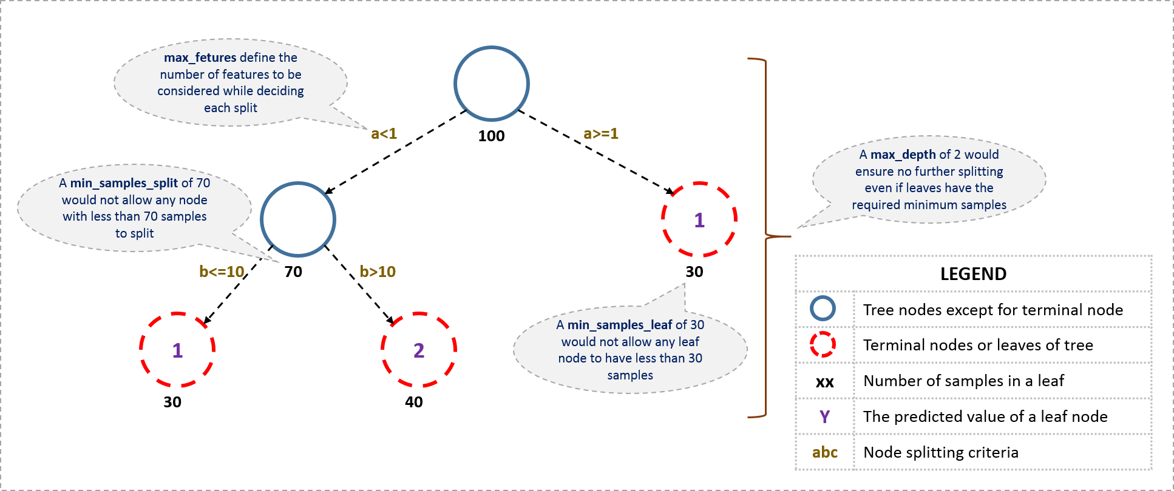
Hyper parameters: Examples

Slide 9
Optimal Parameters Search
It is common that a small subset of hyper-parameters can have a large impact on the predictive or computation of the model and other hyper-parameters can be set to default

Slide 10
Optimal Parameters Search
Optimal Parameters search consists of:
An estimator ( eg: regressor or classifier )
A parameter space
A method for searching or sampling candidates
A cross-validation scheme
A score function

Slide 11
Optimal Hyper Parameters Search
Some models allow for specialized, efficient parameter search strategies
Approaches for optimal hyper parameters search
Manual
Grid search
Exhaustively considers all parameter combinations
Random search (not covered in class)
Automated hyper parameter tuning ( not covered in class)

Slide 12
Grid Search
Grid search is provided by GridSearchCV
Generates candidates from a grid of parameter values specified with the param_grid parameter
Example param_grid for RandomForest:
grid = { "n_estimators" : [100,200,500],
"criterion" : ["gini", "entropy"],
"max_features" : ['sqrt','log2',0.2,0.5,0.8],
"max_depth" : [3,4,6,10],
"min_samples_split" : [2, 5, 20,50] }
The GridSearchCV instance implements the usual estimator API: when ‘fitting’ it on a dataset all the possible combinations of parameter values are evaluated and the best combination is retained

Slide 13
Grid Search
Lab ( “Lab1_gridSearch_MLmodels.ipynb “ )

Slide 14
Tips for parameter search
Specifying an objective metric
Composite estimators and parameter spaces
Model selection: development and evaluation
Parallelism

Slide 15
Pipeline
Pipeline can be used to chain multiple estimators into one.
This is useful as there is often a fixed sequence of steps in processing the data, for example feature selection, normalization and classification.
Pipeline serves two purposes here:
Convenience and encapsulation: We only have to call fit and predict once on our data to fit a whole sequence of estimators.
Joint parameter selection: We can grid search over parameters of all estimators in the pipeline at once.
Safety: Pipelines help avoid leaking statistics from our test data into the trained model in cross-validation, by ensuring that the same samples are used to train the transformers and predictors.

Slide 16
Pipeline : usage
The Pipeline is built using a list of (key, value) pairs, where the key is a string containing the name we want to give this step and value is an estimator object

Slide 17
Data Science Project Life Cycle
Prepare Problem
Load libraries
Load dataset
Summarize Data
Descriptive statistics
Data visualizations
Prepare Data
Data Cleaning
Feature Selection
Data Transforms
Evaluate Algorithms
Split-out validation dataset
Test options and evaluation metric
Spot Check Algorithms
Compare Algorithms
Improve Accuracy
Algorithm Tuning
Ensembles
Finalize Model
Predictions on validation dataset
Create standalone model on entire training dataset
Save model for later use

Slide 18
Data Science Project Life Cycle
Lab ( “Lab2_mlProjectLifeCycleBostonHousePricePrediction.ipynb “ )
Lab ( “Lab2_Extension_customerDeliveryBostonHousePricePrediction.ipynb “ )
Hands-On (“ Lab3_mlProjectLifeCycleKingCountyHousePricePrediction.ipynb “)

Slide 19
Possible Capstone Projects
Consumer complaints data analysis and case outcome prediction
Collect case status data from district, state and NCDRC
Extract important basic info about each case ( using NLP techniques) and add to the features
Build predictive models for the outcome of the complaints
Consumer complaints judgments summarization
Real estate
Healthcare
Similar consumer complaints judgements identification
NLP based features engineering for consumer complaints judgements(may need to use sequential models also)
NLP
Text classification
Language modelling
Speech recognition
Caption generation
Machine translation
Document summarization
Image Analytics
Image detection
Brightness correction in Zoom video call(help speaker to deliver talks with ease)
Weed identification in crops using deep learning techniques
Store monitoring (brands detection etc) and supply chain optimization using deep learning
Psychology analysis using hand written notes
Minimize black edges in photo copying by minimizing the noise ( potential for good patent)
ML Libraries Development
Additional modules to mlxtend
Model tuning
Time series
NLP
Etc …

Slide 20
References
https://www.analyticsvidhya.com/blog/2016/02/complete-guide-parameter-tuning-gradient-boosting-gbm-python/
German Creamer, ‘Using boosting for automated planning and trading systems’, PhD Thesis 2007, https://pdfs.semanticscholar.org/bbb5/b2456ff1b6e493d9b162e17817e70005877f.pdf
German Creamer & Yoav Freund, ‘Automated trading with boosting and expert weighting’: http://andromeda.rutgers.edu/~jmbarr/NYComp/CreamerEEA.pdf

Slide 21
Summary
Grid Search
Pipeline
Data Science Project Life Cycle
Case study

Slide 22
Questions?

